Slide 1
Germany on the road to DAB+ Dr. Willi Steul, Intendant

Slide 2
Stakeholders in Germany
ARD – regional public TV and radio, 9 stations: German federal system
Deutschlandradio, national public radio
Private programs, regional and national
Media Broadcast – network operator
Trade and (car) manufacturers

Slide 3
What are our key perspectives?
Create market impact
Form alliances between stakeholders, even if they are competitors
Diversity in radio programs and products
Unity in how important DAB/DAB+ is
Request politicians for a clear vote for DAB/DAB+
Request car manufacturers to actively include DAB+ radios (with no surcharge)

Slide 4
Joint effort in Germany
German Ministry for Digital Infrastructure: DAB+ broadcast is the successor to FM
No switchoff date yet
Digital Roadmap available December 2016
ARD and Deutschlandradio: Close Alliance
Financing via public fee available
Fresh money for the period 2017-2020
„Hybrid strategy“: DAB+ and Internet used as broadcast channels
DAB+ allows more variety of programs for the same monthly fee

Slide 5
Joint effort in Germany
Private radio
Seeks funding from the state for better DAB+ coverage
Established FM business models need to be adapted
Generating advertising revenue
Coverage: local radio becomes regional radio

Slide 6
German vote on DAB+: yes, no, perhaps?
Public broadcasters: YES
Private brodcasters: a bit YES, a big PERHAPS, and a hardcore rest of NO
Politics: a YES packed in a lot of indifference
Automotive: YES, but waiting for the consumer/regulation
Producers and trade: YES
Consumers
A new DAB+ radio listener never switches back to FM
Many Germans still do not know the advantages of DAB+, since FM coverage is very good and there is no „official“ pressure for a Digital Switchover

Slide 7
Heatmap: variety of programmes
12 national programs
Up to 49 regional/local programs in Munich
Green: 8 – 23 programs
Yellow and red: 33 – 49 programs

Slide 8
Coverage: all multiplexes
90% of Germany
78 m. of 80 m. population
95% of the German population (mobile)

Slide 9
Second national multiplex
Programs on air: summer 2017
Multiplex for private programs, which will drive variety and listnership

Slide 10
Market research: people listening to DAB+ radio*
14%
…that is 9.5 mio. people
have at least one digital radio at home
* Based on the recently published Digitilization report and shows market data of 2016

Slide 11
Market research: people listening to DAB+ radio
35%-
---of all listening happens via DAB+ radio

Slide 12
Market research: listnership with access to DAB+ radio
More than 50%-
of the average listening time
is used for DAB+

Slide 13
Market research: households*
13%
of all Germans listening to DAB+ programs regularily
* Based on the recently published Digitilization report and shows market data of 2016

Slide 14
Market research: households
DAB+ especially well established in:
Saxony, Bavaria and Baden-Wuerttemberg

Slide 15
Market research: households
5 mio. households
own at least one DAB+ radio

Slide 16
Market research: households
1.2 million
DAB+ radios will approximately be sold by December 2016

Slide 17
Market research: households
8.2 million
DAB+ radios in use in Germany

Slide 18
Market research: cars
98%
of all highways
have very good DAB+-coverage

Slide 19
Market research: cars
More than 3 mio.
DAB+ radios are in use in cars

Slide 20
Market research: cars
Every 13th car radio
operates on DAB+

Slide 21
Market research: cars

Slide 22
Get a DAB+ radio in y0ur car today
Don’t risk a silent radio when the digital switchover takes place
Enjoy digital programs all over Europe
Make use of TPEG traffic quality services
DAB+ radios still receive FM

Slide 23
DAB+ in cars
DAB+ car radios are mostly an option
Over the last two years prices have come down
Surcharge range: 70 – 250 Euro
Some brands(Skoda, Renault etc.) offer DAB+ without surcharge
Manufactures will follow the market, as in the U.K., Switzerland, and Norway

Slide 24
Content drives the market
Two strong consumer groups: „young“ and „old“ adopter:
From 14 to 29 years:
1/3 of all DAB+ radio buyers, driven by special interest programs such as DRadio Wissen
Older than 60 years:
Prefer listening to „Oom-pah“ folk music, classical music, and talk
Currently 600 DAB+ capable receivers available
A digital radio is NO luxury, it is an everyday tool

Slide 25
digitalradio.de
http://www.digitalradio.de/index.php/de/. Joint effort with ARD

Slide 26
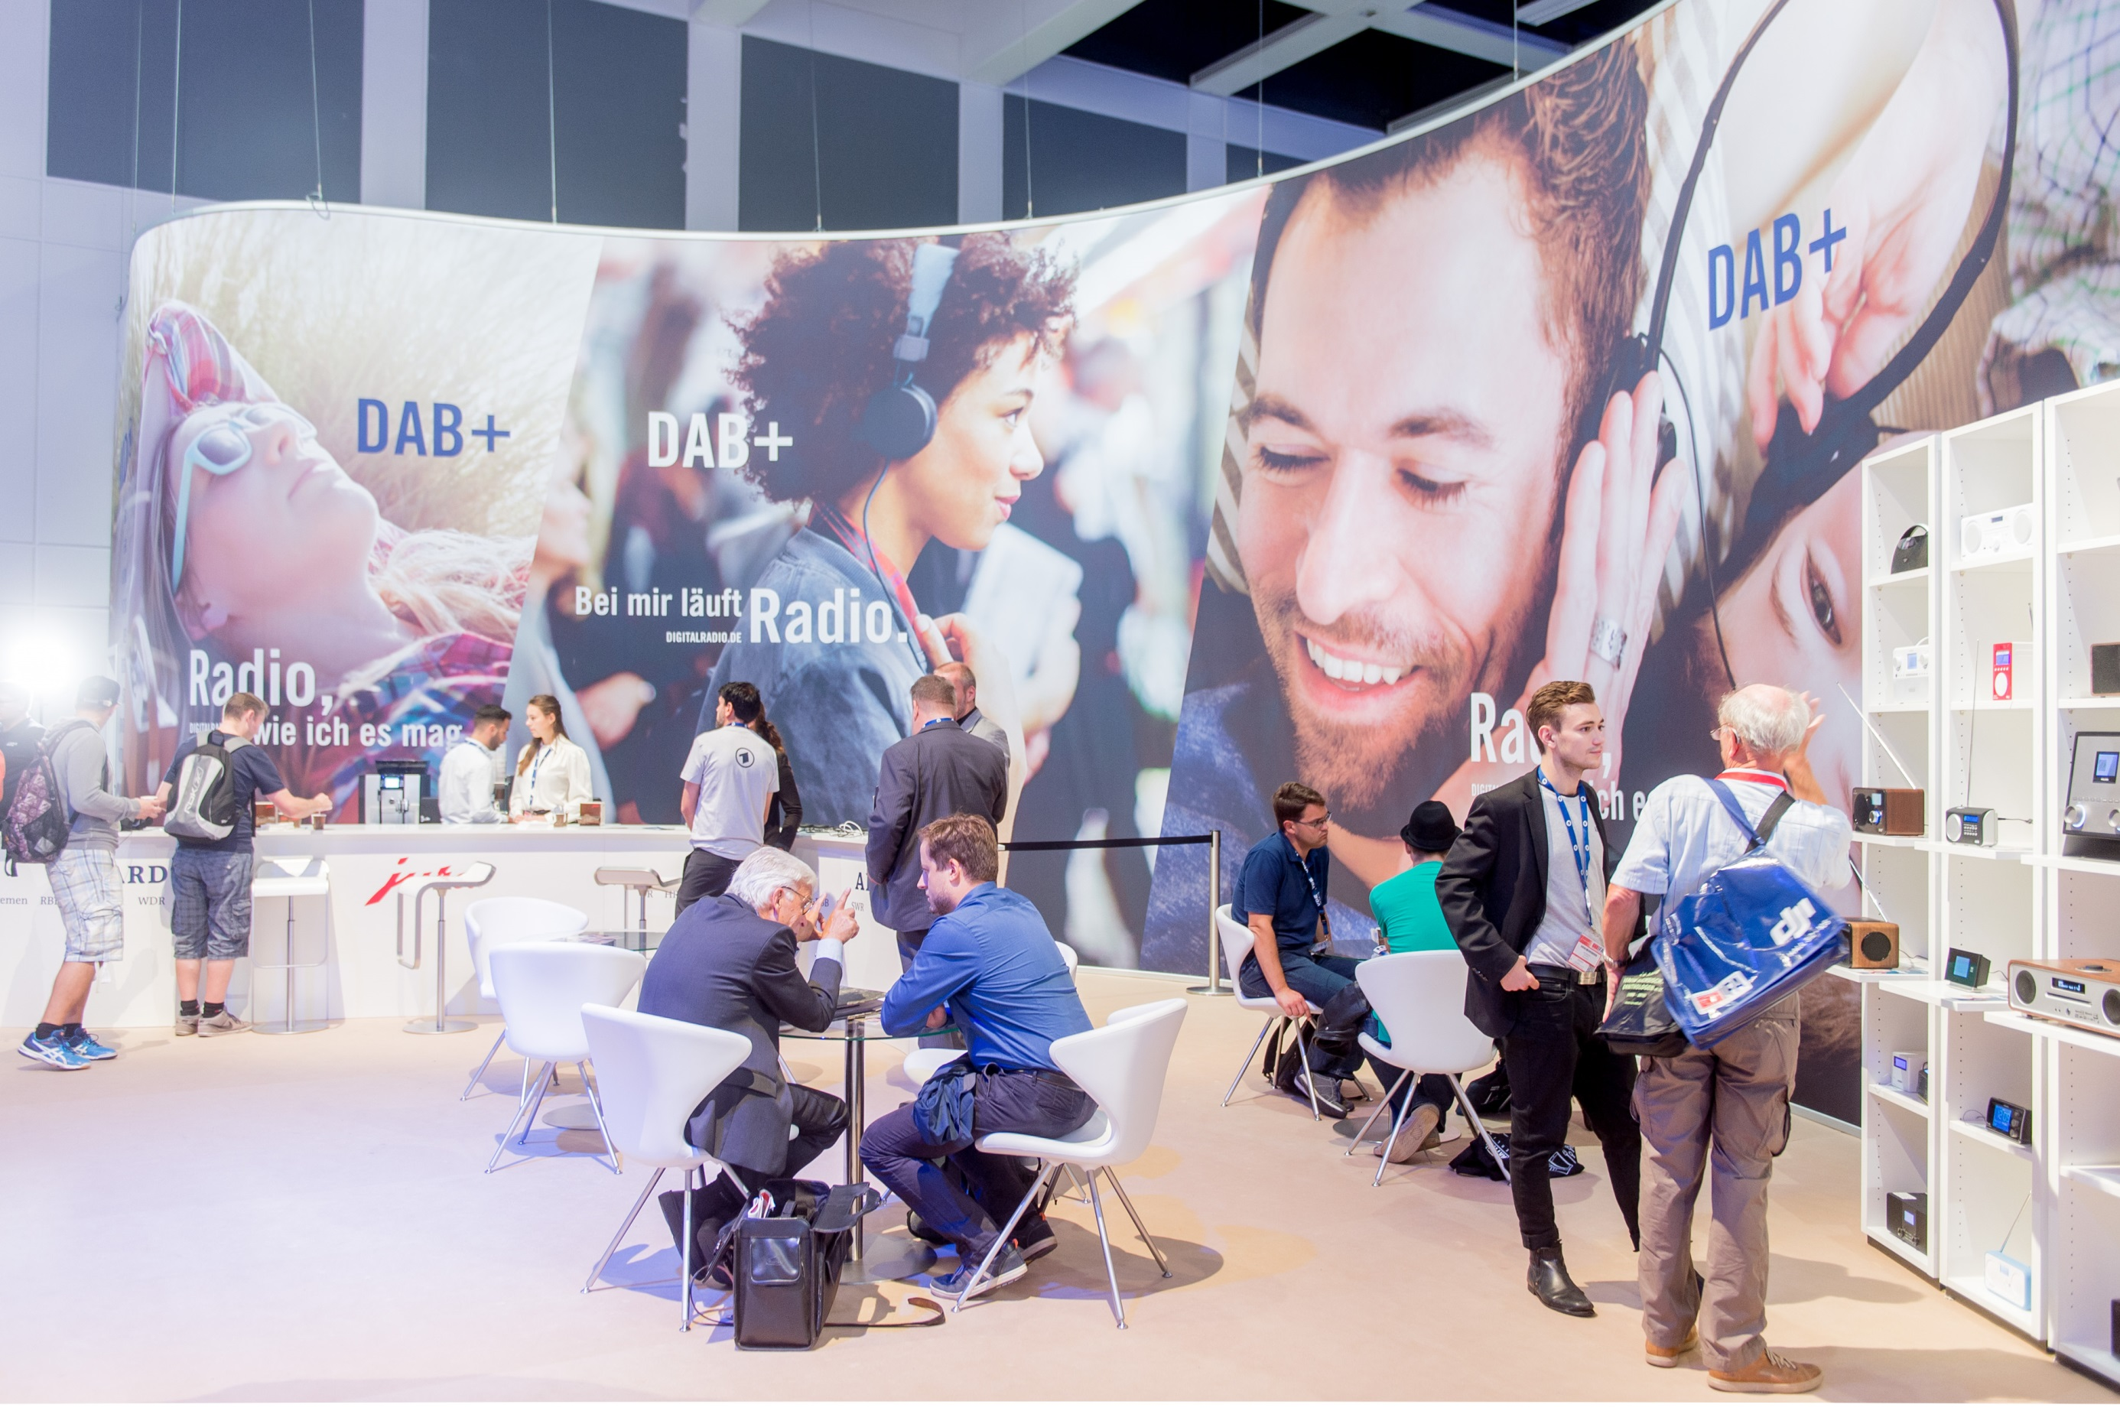

Slide 27
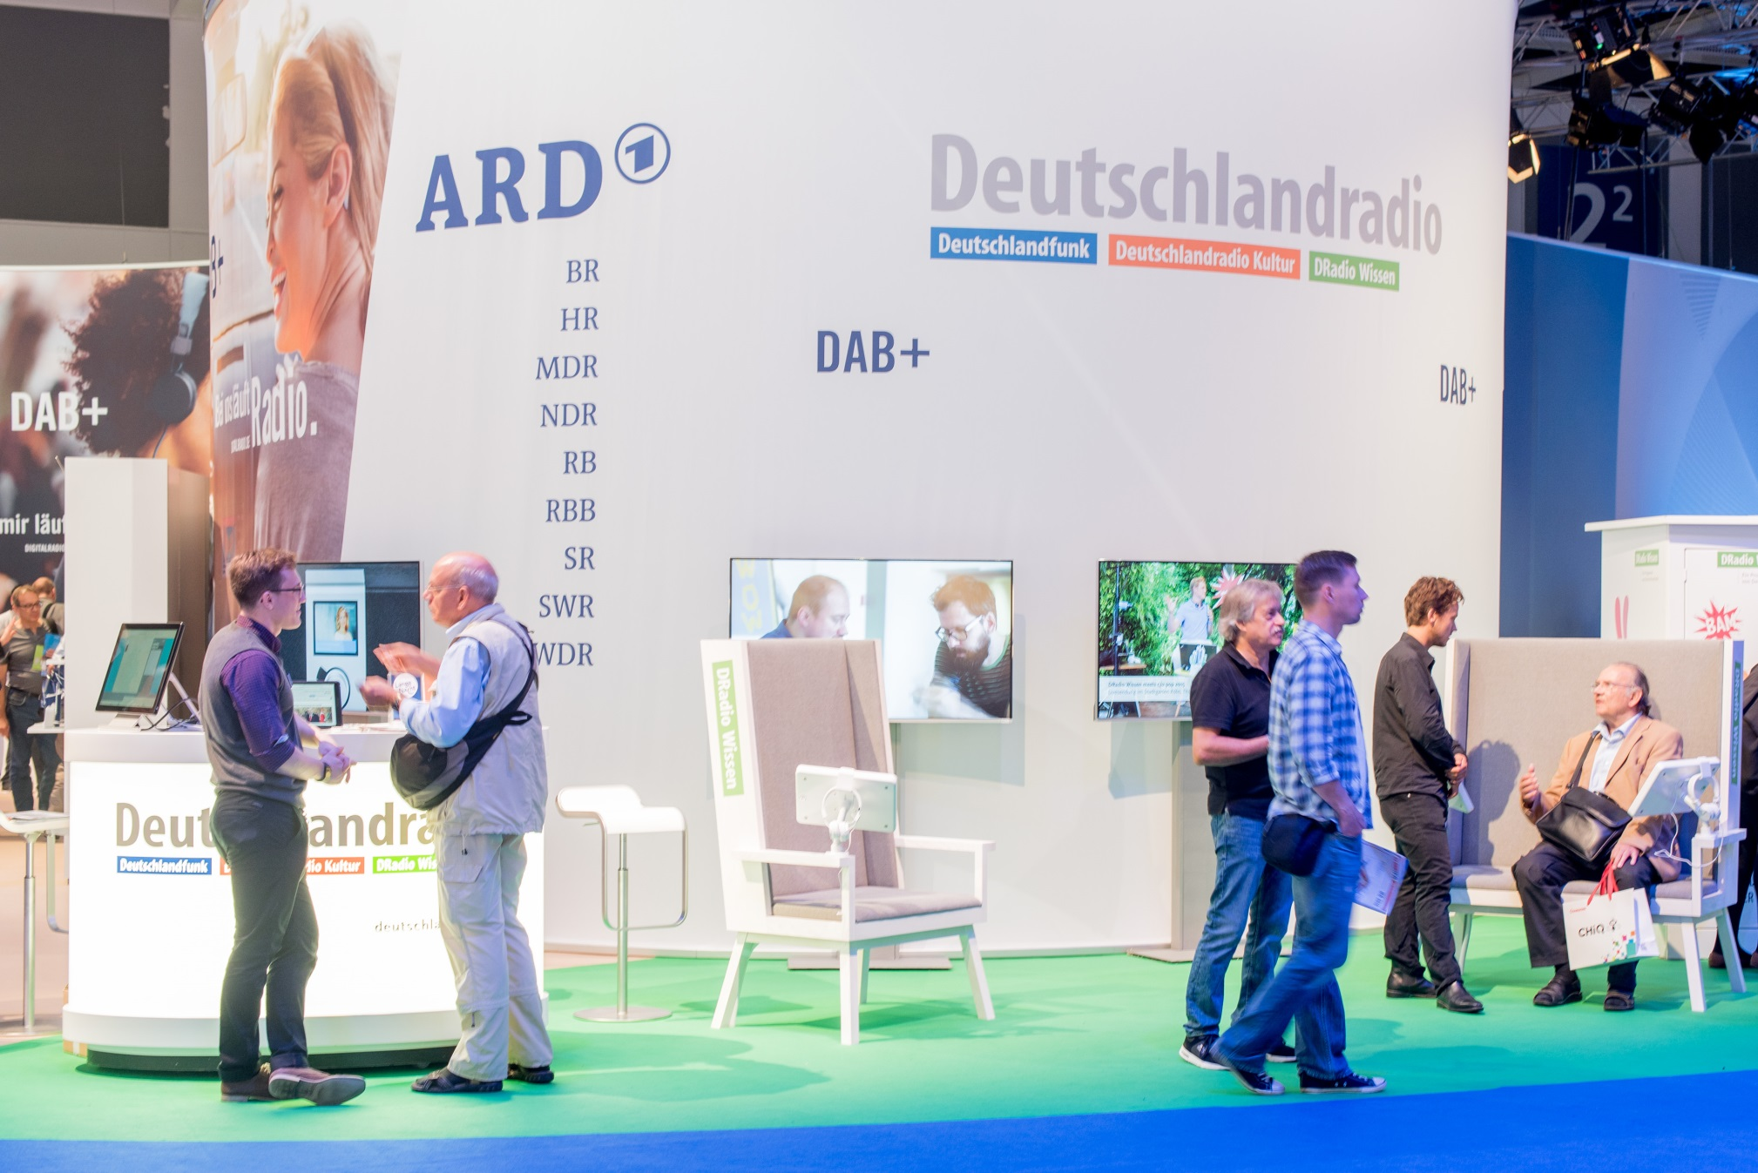

Slide 28
