Slide 1
DAB in automotive Michal Šimůnek

Slide 2
Skoda cars produced with DAB (worldwide)

Slide 3
Percentage of Skoda cars produced with DAB in 2016

Slide 4
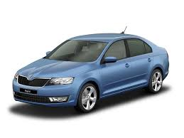
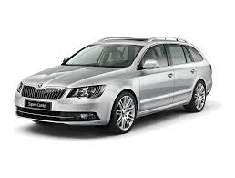
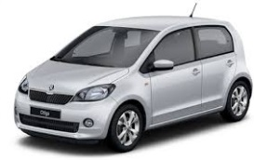
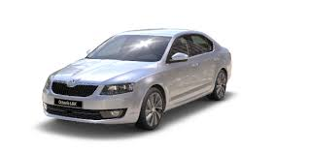
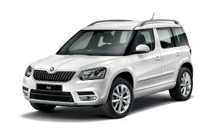
DAB tuner as standard in Skoda
Norway
UK, Switzerland
Germany
better equipment only
Czech Republic

Slide 5
Conclusions
People are paying for DAB option
Number of cars produced with DAB is growing
DAB as standard is country specific

Slide 6
DAB growth
Whole VW AG group is supporting DAB and hybrid radio growth
Technology
Legislative
Cooperation
Customers

Slide 7
DAB growth - Technology
ETSI
World DAB
Module sharing (VW AG group)
Workshops with tier2 suppliers

Slide 8
DAB growth - Legislative
DAB broadcasting rollout - reaction
Author rights (e.g. logos)
Country specific requirements
Classification

Slide 9
DAB growth - Cooperation
VW AG group discussion
Broadcasters and radio stations
European cooperation

Slide 10
DAB growth - Customers
Feedback – cliniques, service centers
European agencies reccommendations
Complaints

Slide 11
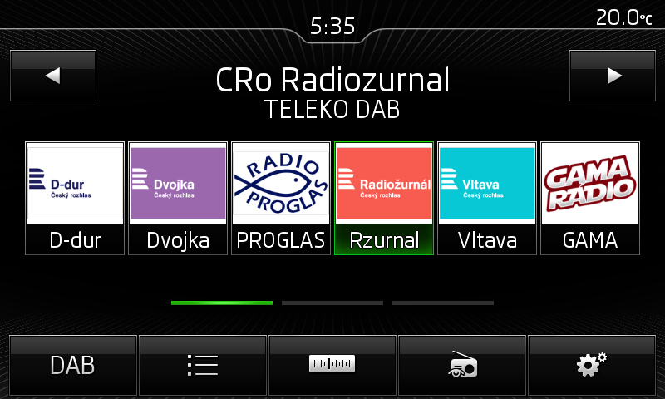
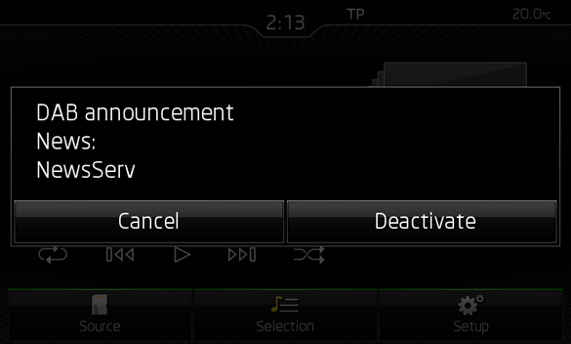
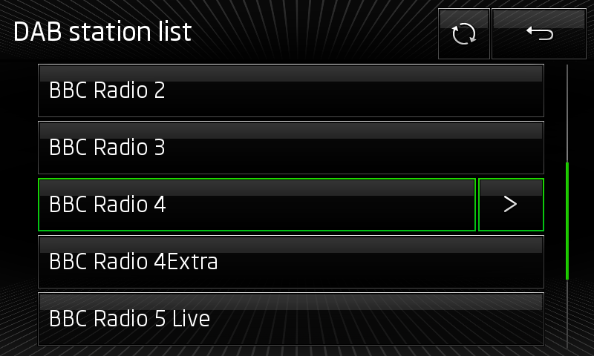
DAB current funtions
Slideshow
DLS/DLS+
Station list
All announcements

Slide 12
Future of DAB in cars
Hybrid online radio – already started development
Unified approach (list, presets)
Supporting roll-out
Spreading information

Slide 13
Thank you

