Slide 1
DAB Radio in the Czech Republic

Slide 2
CZECH RADIO
Public Service Broadcaster
Long History since 1923
Modern and Progressive Media house
Active Member of EBU
Important Part of Czech History and Present Life
Market Share 23%
Financed by Licence Fees (app. 95% of Budget)

Slide 3
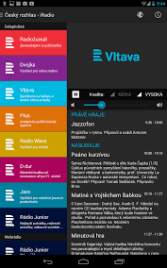
CZECH RADIO - Content and Offer
3 Traditional Nationwide Radio Channels
14 Regional Radio Channels
8 Special Thematic Digital Channels
Plenty of Websites
Social Network Activities
On line broadcasting (streaming)
Mobile applications
Podcast of huge Czech Radio archive

Slide 4
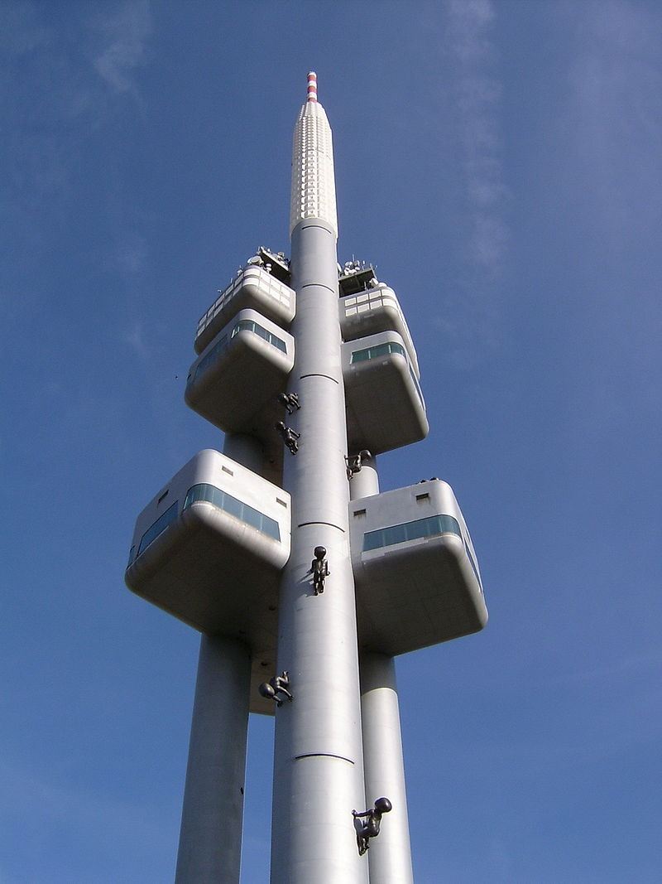
DISTRIBUTION PLATFORMS
Analog Broadcasting
FM (core platform)
AM (still alive)
Digital Broadcasting
Satellite TV (DVB-S)
Terrestrial TV (DVB-T)
On-line (streaming)
DAB+

Slide 5
DAB+ Pros and Cons
Pros
New Content
New Services
Sound Quality
Easy to Use
Energy, Frequency and Cost Efficiency
Robust in Crisis Communication
European Standard for Digital Radio
Free to Air

Slide 6
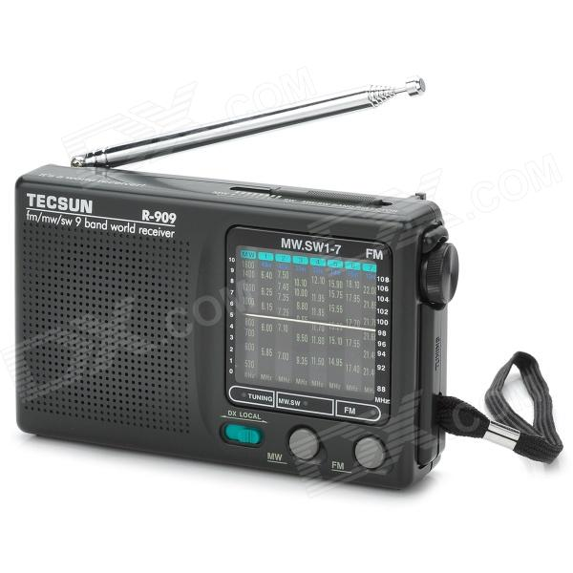
DAB+ Pros and Cons
Cons
New Receivers Investment
New Network Investment
Parallel Broadcasting Costs
Old Platforms Competitors (FM)
New Technology Competitors (Internet, etc.)

Slide 7
DAB+
Key issues to solve
Political will and support
Legislative and long-term national DAB strategy
Motivation of Private Broadcasters
Promotion and marketing of DAB and its advantages

Slide 8
DAB+
Conclusion
DAB+ is not the only future platform for radio
But it has all attributes to become the future of the radio; Important especially for PSM
DAB development is one of the priorities of Czech Radio

Slide 9
DAB+ in Czech Radio - HISTORY
Beginning of DAB in the Czech Republic
First tests since 2000
World DAB General Assembly in 2005 in Prague - full DAB multimedia broadcasting tests including video
DVB-T like a pool for developing new DAB content

Slide 10
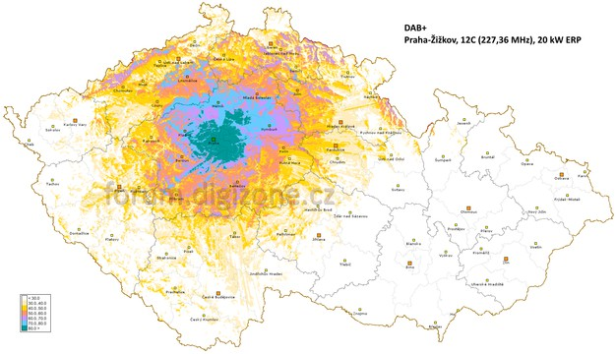
DAB+ in Czech Radio - TODAY
DAB Prague (special project)
Experimental broadcasting but with final parameters
Public Service Multiplex
20 kW radiated power

Slide 11
DAB+ in Czech Radio
DAB Prague - Content
Traditional Czech Radio channels
CR Radiožurnál
CR Dvojka
CR Vltava
New digital Czech Radio channels
CR Plus
CR Radio Wave
CR Rádio Junior
CR D-dur
CR Jazz
CR Regina DAB Praha
CR Rádio Retro
CR Sport

Slide 12
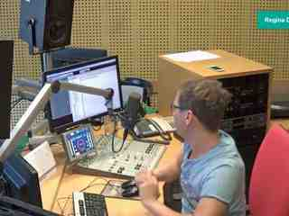
DAB+ in Czech Radio
DAB Prague - Multimedia Services
Slide Show - pictures
Camera View
Dynamic Label Segment - text

Slide 13
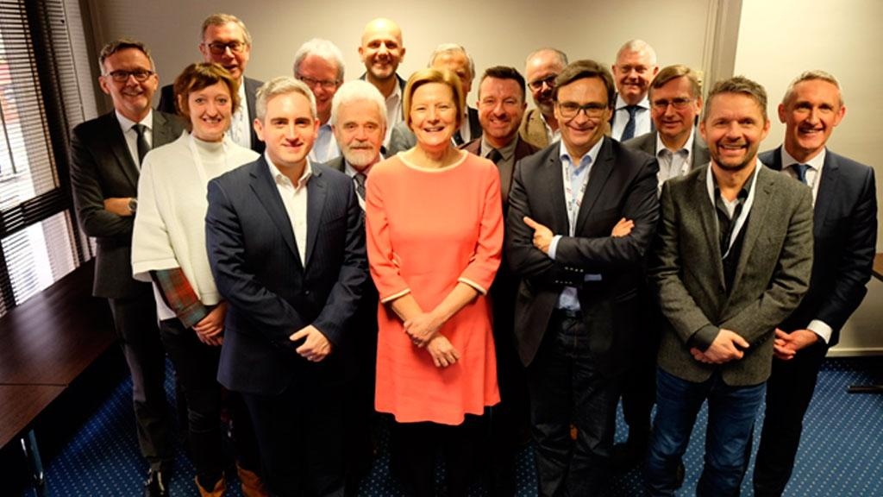
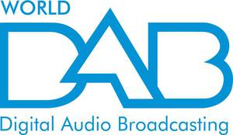
DAB+ in Czech Radio
Czech Radio – Active Member of EBU
Czech Radio – Co-founder Member of EDRA
Czech Radio – Active Member of Word DAB
EDRA

Slide 14
The Future of DAB+ in Czech Radio
Official DAB strategy approved by government as the temporary solution for 5 years
Main national DAB strategy postponed till 2021
Czech Radio can start to build the first final DAB network in the Czech Republic
But the content of PSM is strictly reduced to only 4 Channels which already are on FM
Private Radios are strictly in opposition to DAB

Slide 15
The Future of DAB+ in Czech Radio
Czech Radio is ready for regular DAB+ broadcasting:
Technology is already in use
Content is ready including 8 digital only channels
Multimedia Services are developed and in use
Finance for DAB are allocated inside existing Czech Radio Budget
Important to solve:
Support of politicians, real long-term national strategy
Involving and motivating Private Broadcasters

Slide 16
Czech Radio | Vinohradská 12, 120 99 Prague 2 | www.czechradio.cz

